Slide 2
NotiVal
A value based smart notification system
Notes:
Supervision Birna van Riemsdijk & Myrthe Tielman

Slide 3
NotiVal
A value based smart notification system

Slide 5
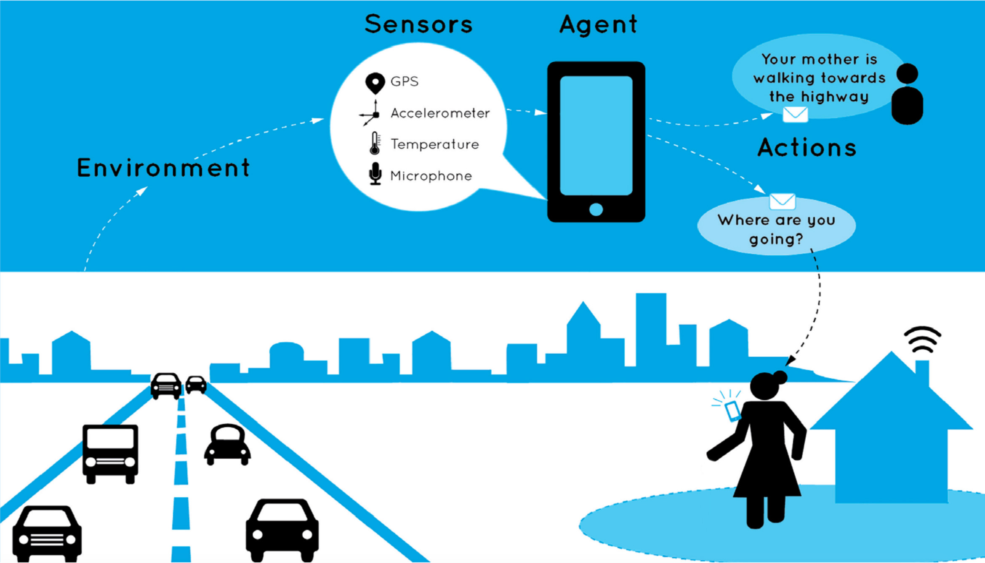

Notes:
CoreSAEP – socially adaptive electronic partner.
Broad – looking at norms and values.
Geofencing thing - too rigid
Something simpeler -> forgetting her walking cane / umbrella
Not overwhelmed with notifications

Slide 6
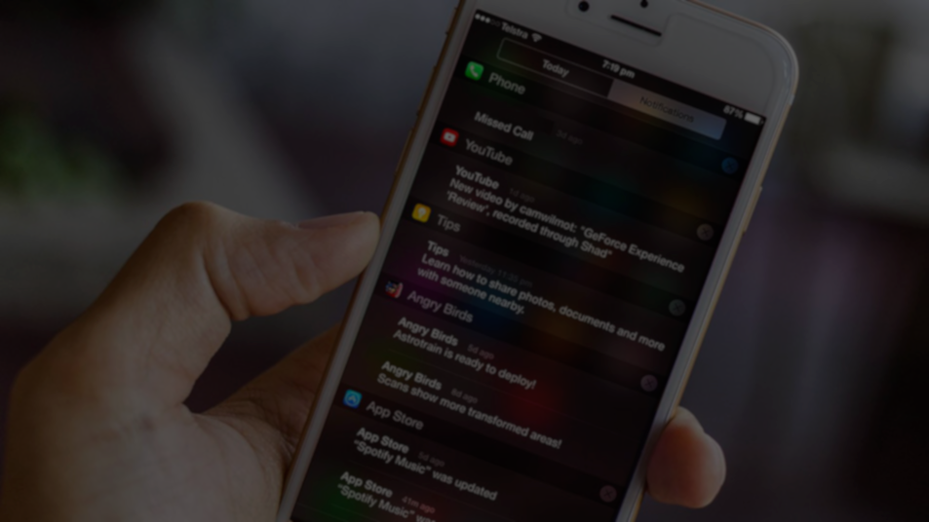
When to notify?

Slide 7
When to notify?

Slide 8
Notes:
Two questions that need answering:
- How to predict a next activity
- How to find the activity we care about least when being interrupted

Slide 9

NotiVal
Introducing
Notes:
Aims at combining that prediction of future activities with your values for certain activities to find the ideal moment to notify
Based on two concepts from papers
What I want from the audience:
Feedback on this method of predicting
Feedback on coupling values to activities for the choice of moments

Slide 10
NotiVal
Introducing
Notes:
Combine
activity prediction
User values

Slide 11
Watching TV – Promotes Happiness
Do work – Promotes Career
07:45
8:15
08:00
09:00
Brushing teeth – Promotes Health
Lock doors when leaving. – Promotes Safety
Notes:
Assumptions: Explain that we have this in dataset or will still collect through an app
Interruption might not ruin value, requires separate data.

Slide 12
?
Notes:
Statistically we can do this, but inaccurate. So how to improve

Slide 13
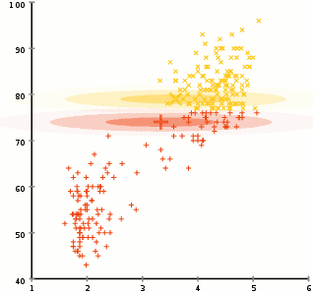
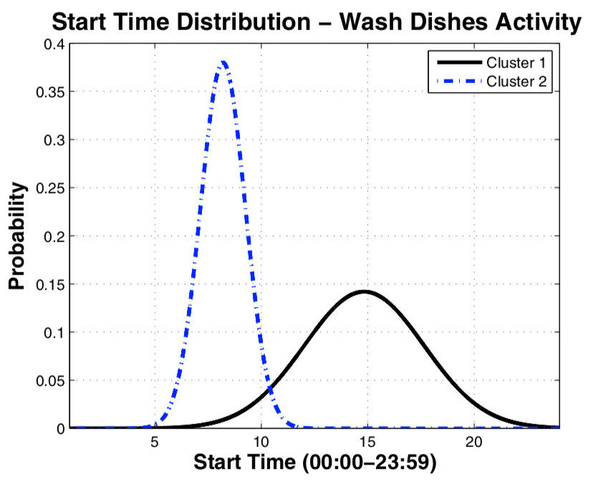
Expectation Maximization
& Apriori algorithm
Watching TV
57 %
Leaving Home
20 %
Duration (min)
Watching TV
40 %
Showering
55 %
Start (h)
Notes:
Two concepts from ML
Expectation Maximization – iterative method to find best parameters for Gaussian mixture models
Apriori algorithm (datamining algorithm) to identify temporal relations
Every cluster has probability of next activity

Slide 14

Expectation Maximization
Duration (min)
Start (h)

Slide 15
Notes:
Typical day modeled with these consecutive predictions

Slide 16
G
L
G
L
G
L
G
L
G
G
L
L
G
L
G
L
G
L
G
L
G
G
L
L
G
L
G
L
G
L
G
L
G
L
Notes:
Add values

Slide 17
Notival
Don’t forget to take your umbrella/walking stick/keys

Slide 18
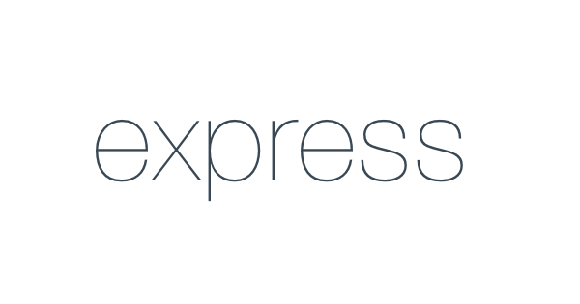
Notes:
Why do we have this? Any service or dataset

Slide 20
NotiVal
A value based smart notification system

